Slide 1
CSE332 INDUSTRY ETHICS AND LEGAL ISSUES

Slide 2
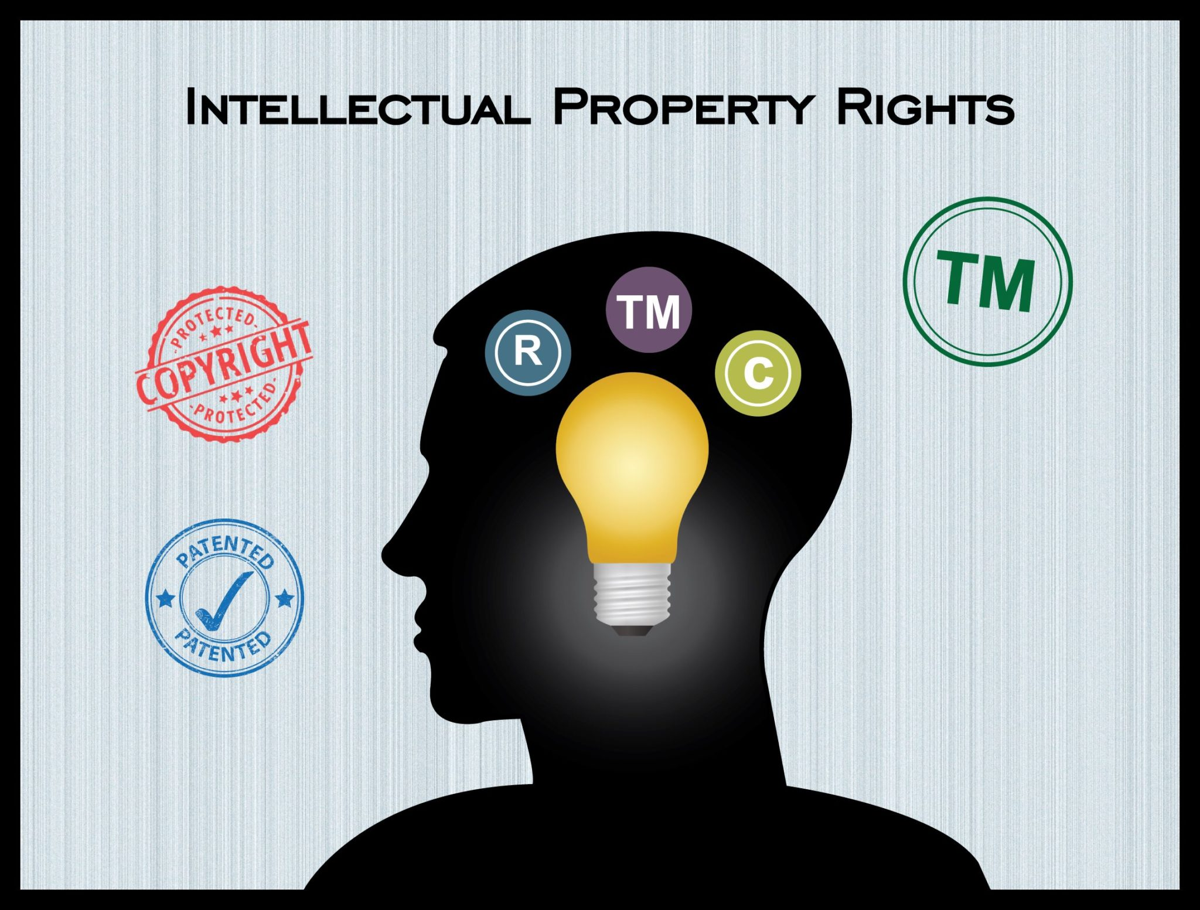
Intellectual property rights
Intellectual Property Rights (IPR) are legal rights.
It protect and encourage the development and distribution of new products and services.
IPRs are granted to people over their creations.
Such as inventions, designs, trademarks, and creative content.

Slide 3
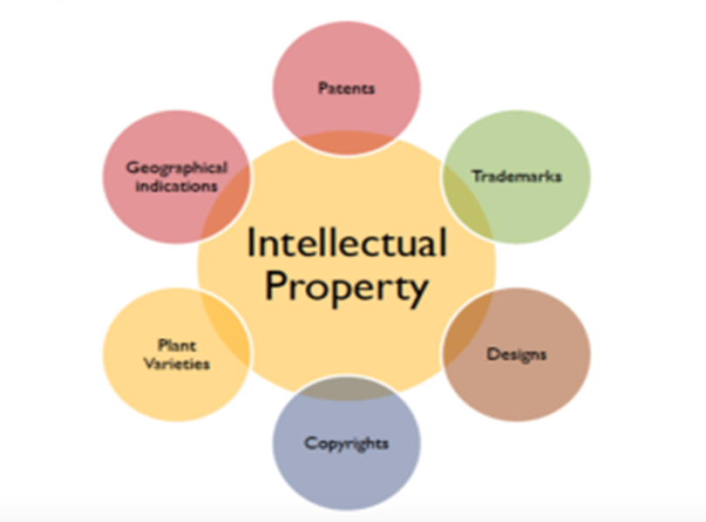

Slide 4

“A patent is a legal document that gives the inventor exclusive rights to their invention for a set period of time.”
It protects the invention from being made, used, or sold without the inventor's permission.

Slide 5

Copyright
Copyright is the right to copy.
Only the creator of the work can authorize anyone to reproduce the work.
Copyright law protects creators of original material from unauthorized use

Slide 6




Things take place under copyrights
Novels
Art
Poetry
Musical lyrics and compositions
Films
Website content

Slide 7

Trademark
A trademark is a sign capable of distinguishing the goods or services.
Trademarks are protected by intellectual property rights.
Trademark protection can be obtained through registration.
It will confer an exclusive right to the use of the registered trademark.

Slide 8

Trade-Secret
A trade secret is a confidential piece of information.
Secrecy: The information is not generally known or accessible to competitors
Commercial value: The information gives the business an economic advantage
Reasonable efforts: The business takes steps to keep the information secret

Slide 9
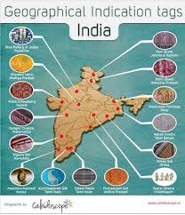
Geographical Indication
A geographical indication (GI) is a name or sign that identifies a product's geographical origin.
GIs are used to certify that products are made in a specific place using traditional methods.
GIs help consumers identify quality products.
GIs help producers market their products.
GIs prevent other people from using popular product names.

Slide 10
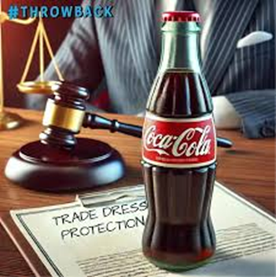
Design
It protects the visual appearance of a product or part of it.
Design rights protect the unique look of a product, including its shape, color, pattern, texture, and materials.

Slide 11
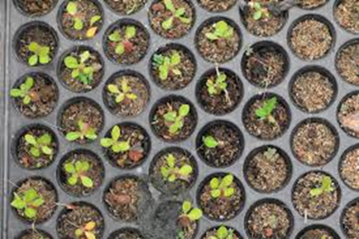
Plant varieties
“PVRs protect breeders from unauthorized reproduction, production, marketing, selling, importing, and exporting of their plant varieties.”

Slide 12
Next Topic Copy Right Infringement

